Slide 1
Application of Data Science Method on Organic Photovoltaic Materials
Jingtian Zhang’s Non-thesis Report
Committee members: Samson A. Jenekhe, Fumio Ohuchi
12/09/2019

Slide 2
Content
Introduction
Research objective
Methods
Results and Discussion
Conclusion
Future work

Slide 3
Introduction
Data science has been applied extensively in different academic fields of natural science and engineering
Studying polymer with data science (DS)-driven method is still limited due to many reasons
Organic photovoltaic (OPV) materials have complicated driving mechanisms and convoluted relationship between structure and property and device fabrication process
Application of one DS method on OPV materials
Notes:
Data science has been applied extensively in different academic fields, including natural science and engineering
Studying polymer with data science – driven method is still limited due to many reasons
Organic photovoltaic (OPV) materials have complicated driven mechanisms and convoluted relationship between structure and property and device fabrication process

Slide 4
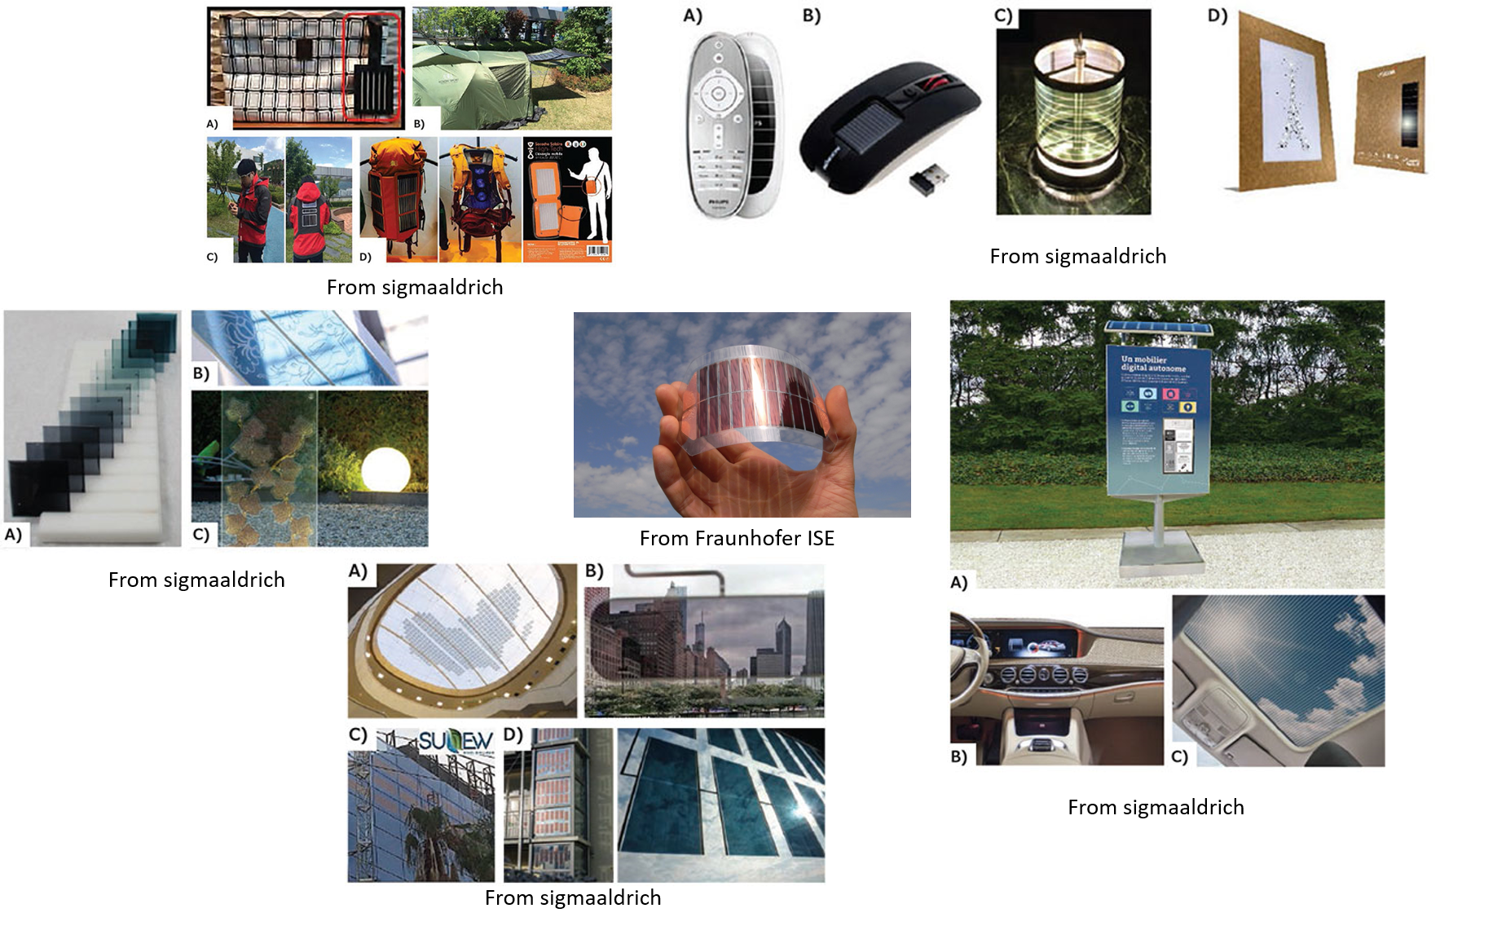
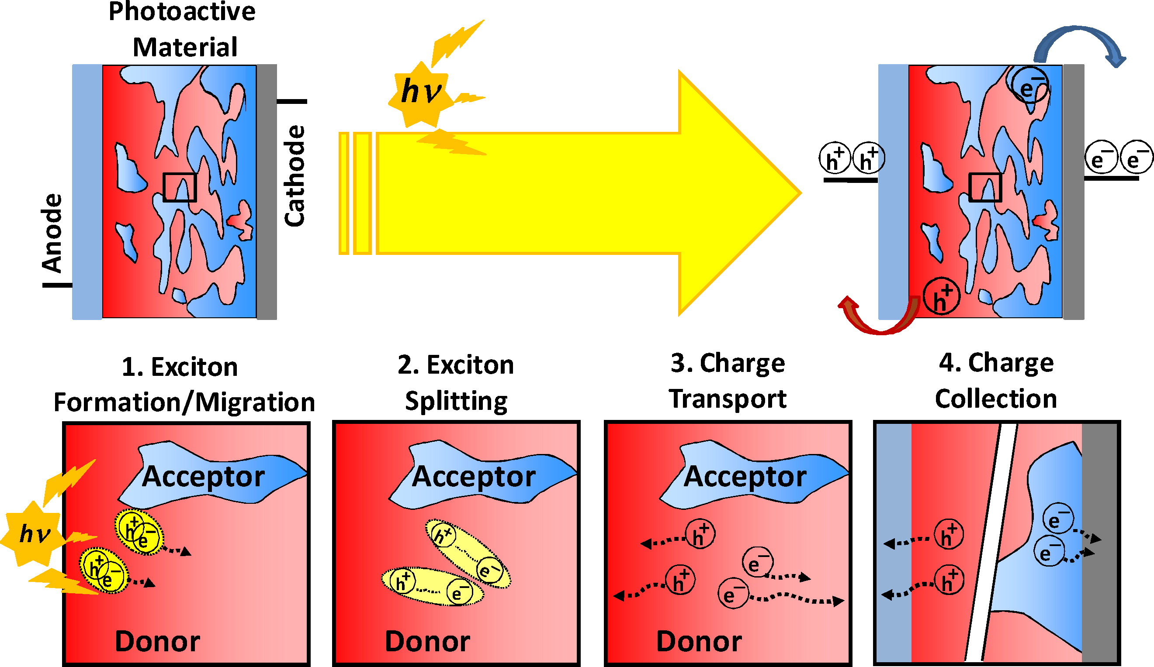
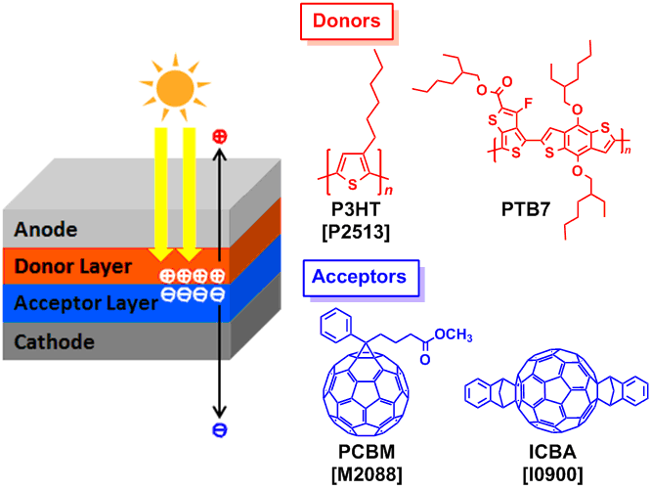
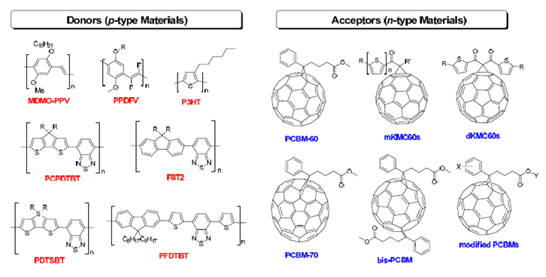
Application
Mechanism
Facchetti, A. Polymer Donor–Polymer Acceptor (All-Polymer) Solar Cells. Materials Today 2013, 16 (4), 123-132.
Structure
Classification of Materials
From tcichemicals
Bagher, Askari. Mohammad. "Introduction to Organic Solar Cells." Sustainable Energy 2.3 (2014): 85-90.
Notes:
Application:
Mechanism:
Structure: Typical BHJ structure,
Classification of materials: PSC / OSC / OPV -> polymer donor and acceptor, mostly fullerene acceptor

Slide 5
Data Science on Polymer Study
Uniqueness and the size of the data of materials may also advance the development of data science, and its application
Materials Research: Explosion of data to be processed
Data Science: Rapidly evolving
More and more new materials from reported literatures
Needs for engineering of materials with more insights and direction
New Data Sciences tools are developed constantly in a fast pace
Better computational power
Cloud computing, HPC
Data Sciences Tools can improve the quality and speed of materials design and engineering
Lack of awareness and efforts from communities

Slide 6
Research Objective
Purpose of study: Understand the uniqueness of polymer materials for data science approach
Importance of using data science in polymer/composite materials
Challenge of the using data science in polymer materials
Great amount of data reported but lack of a database
Not ordered materials, more uncertainty involved
Extremely high dimension, curse of dimensionality
Limited uses of SMILES
Combining 2 data science tools: Self Organizing Mapping (SOM) and Molecular Descriptor Generator (MDG)
Illustration of generating SOM cluster map by using the design matrix (Jsc, Voc, FF, Mw and HOMO) and projecting molecular descriptors on the cluster map to visualize the pattern of distribution J. Zhang, E.Jiang, A.Saeki, F. Ohuchi, Y.Huang etc.

Slide 7
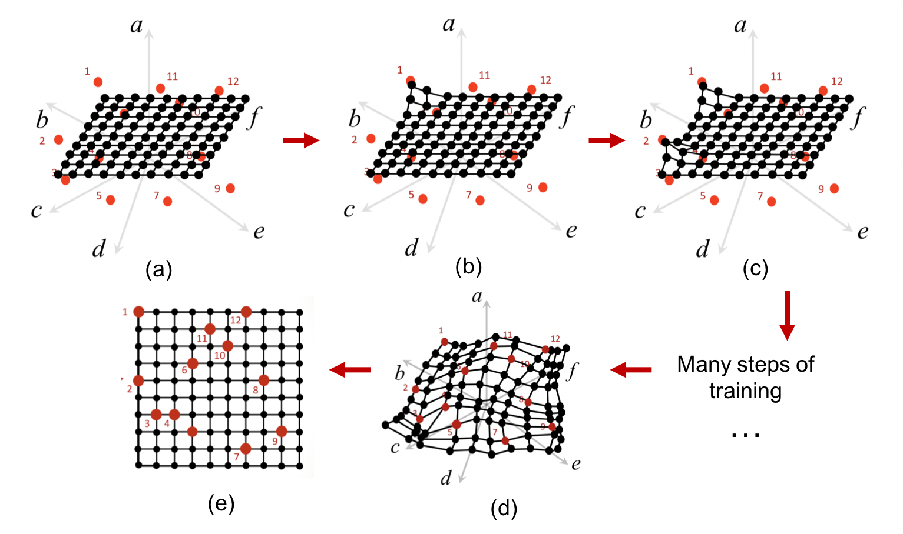
Self Organizing Mapping (SOM)
A dimension reduction tool with powerful clustering and visualization function
1 to 1 relation between study object to any characteristic in the data set
Sorting depends on similarity
Pros:
quick analysis
powerful visualization
Doesn’t need too many data points
Easy to access and small learning curve
Cons:
Can’t support quantitative analysis easily
Can only work on single value numerical data
Notes:
SOM is an algorithm invented by Kohonen in 1980s. Its main purpose is to reduce dimension to avoid the curse of dimensionality to gain a clear insights of data. It belongs to unsupervised machine learning and currently being applied widely in different industries, such as bioinformatics and material science. It has been applied on inorganic substances to reveal how materials cluster based on their properties, as a validation of effective usage of SOM in MSE. In this case, we take one step further to validate how SOM can help us on OPV research.

Slide 8
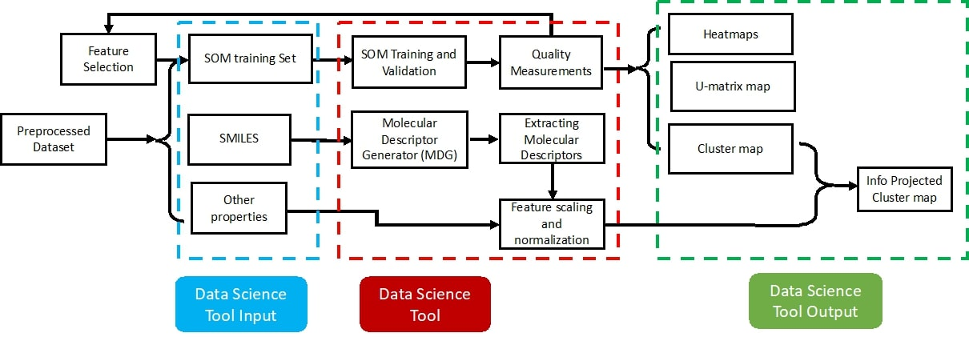
Method - Workflow

Slide 9
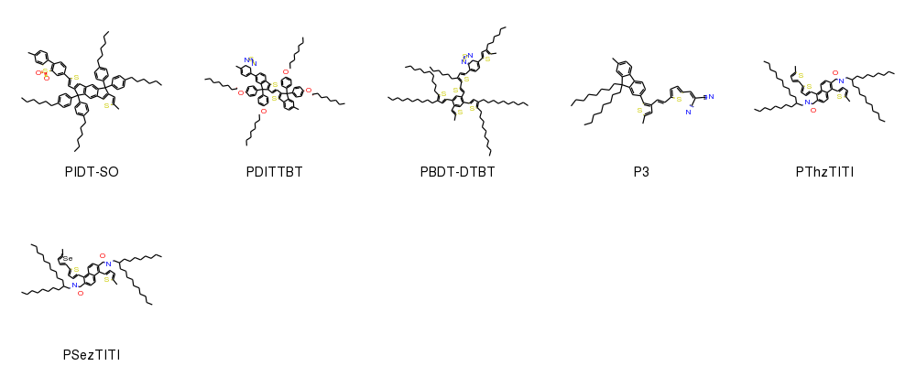
Method - Dataset
Original dataset
Computer-Aided Screening of Conjugated Polymers for Organic Solar Cell: Classification by Random Forest
• Experimental data manually collected from more than 500 literatures
Contains 1203 OPV donor materials with 12 properties, including SMILES
Available data: PCE, Jsc, Voc, FF, Mw, Mn, PDI, Monomer,
HOMO, LUMO, Eg, SMILES
Data preprocessing was done, including averaging the range values
Design matrix formed by combining Jsc, Voc, FF, HOMO and Mw
Notes:
Based on the statistical analysis done in the paper and trials and error, 5 properties are chosen to form the design matrix that present the best clustering.
Data collection rules → 100 – 200 nm, normal BHJ structure, Jsc and Voc curve on the

Slide 10

Method – Molecular Descriptors Extraction
Mordred Molecular Descriptor Generator (MDG) is a Rdkit-based python package that extracts molecular descriptors from SMILES
Can calculate up to 1825 molecular descriptors from SMILES
Based on the study, we found several molecular descriptor can bring meaningful conclusions combining with our SOM results
SMILES, SMARTS,
Mordred Descriptor Generator (MDG)
Descriptor values
sdf, smi

Slide 11
Method – Information Projection
Projecting property values of each material on the corresponding node on the map
Numerical values are categorized and then projected on the cluster map for easier visualizations
Finding correlations between each descriptor and performance (PCE)
Target materials of interest by reading corresponding ID number (can printed on the point)
Molecular descriptors
Only statistically or physically dominant ones are projected
Constitutional descriptors
Topological descriptors
nF, nS, nN, etc.

Slide 12
Results and Discussion
SOM Results and Visualizations
Case studies

Slide 13
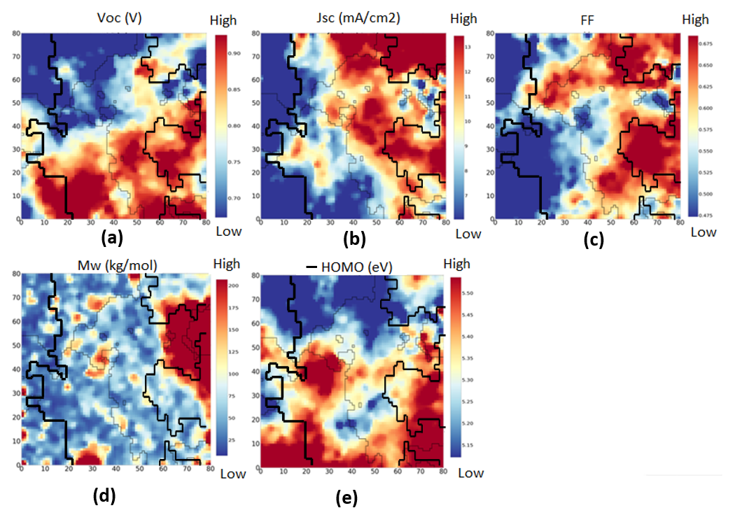
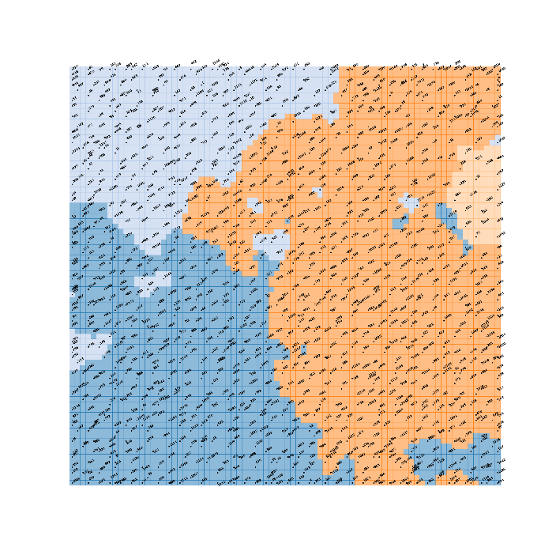
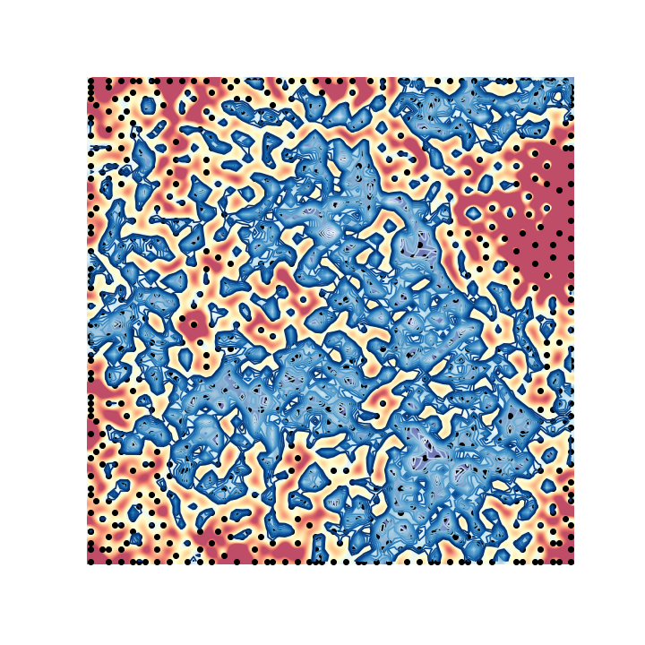
Visualization
Heatmaps of the design matrix
Cluster map
U-matrix map
SOM provides strong visualization tool, including a cluster map, a U-matrix map, multiple heatmaps and others
Optimization
Map size of 80 x 80 → each node match no more than one data point
Minimization of both topographic error and quantization error
Notes:
High Mw does not necessarily yield high performance
Regions with high PCE tend to have high Jsc, high Voc, high FF, relatively high Mw or any two of them

Slide 14
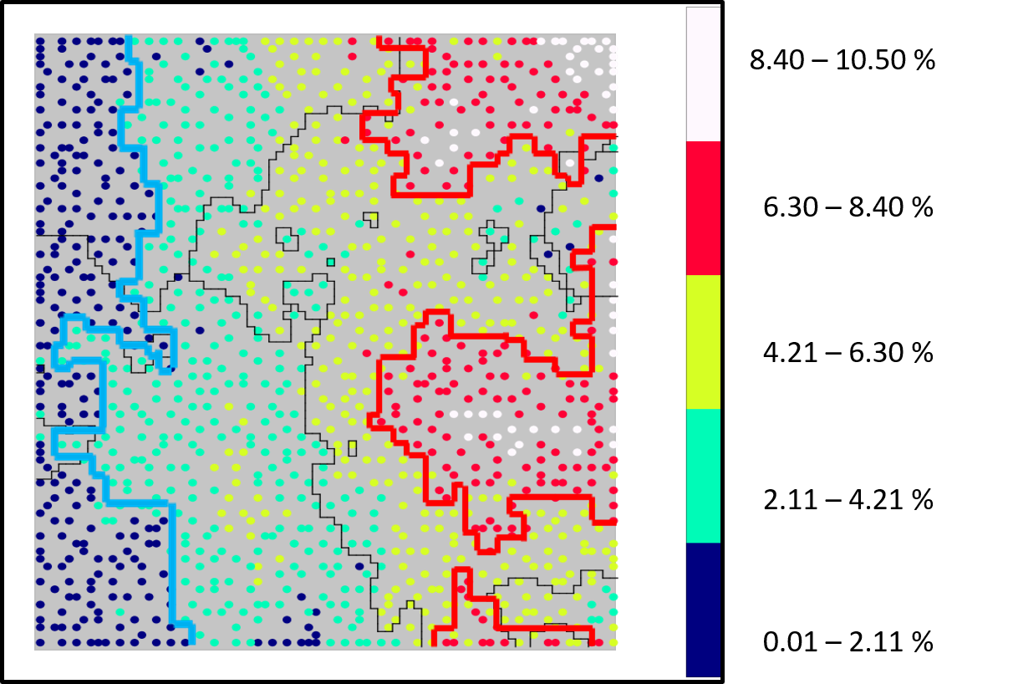
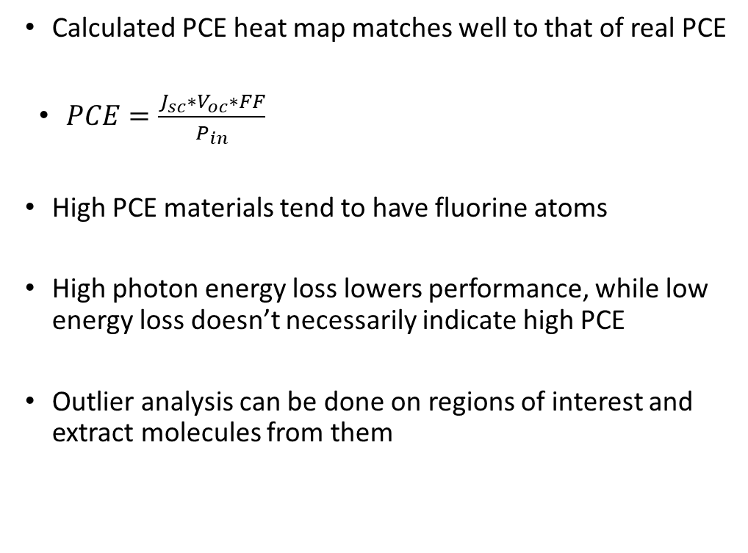
PCE
Calculated PCE heat map matches well to that of real PCE
$PCE=\frac{J_{sc}∗V_{oc}∗FF}{P_{in}}$
High PCE materials tend to have fluorine atoms
High photon energy loss lowers performance, while low energy loss doesn’t necessarily indicate high PCE
Outlier analysis can be done on regions of interest and extract molecules from them
High
Medium
Low
Projection of real PCE on the cluster map

Slide 15
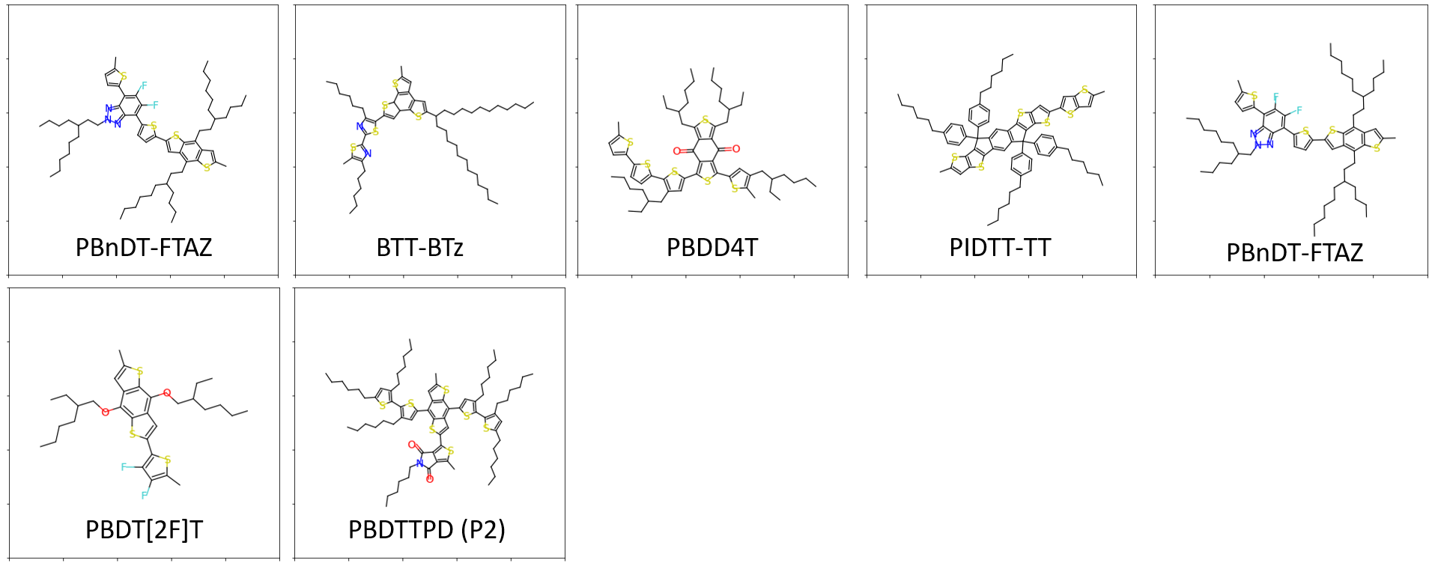
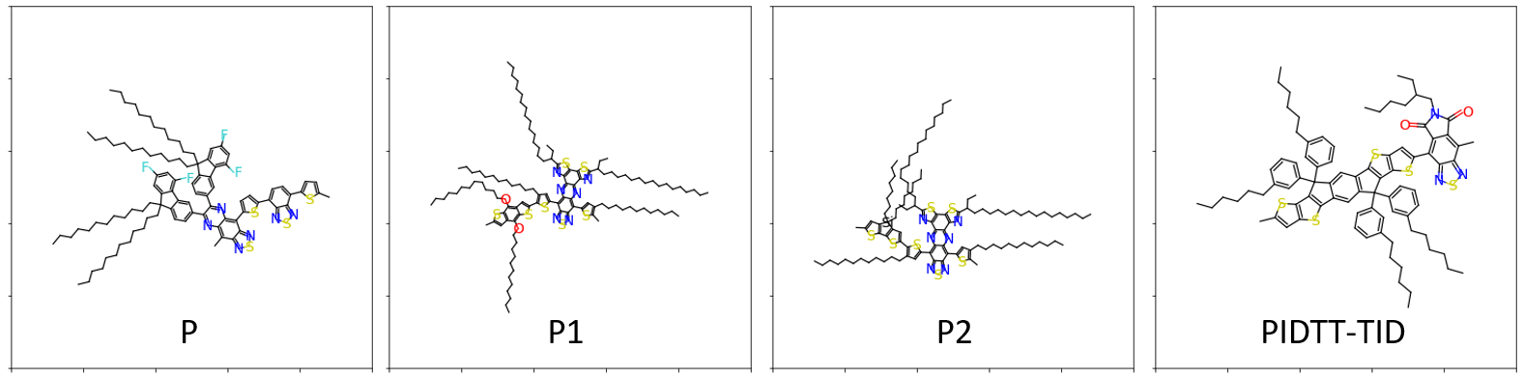
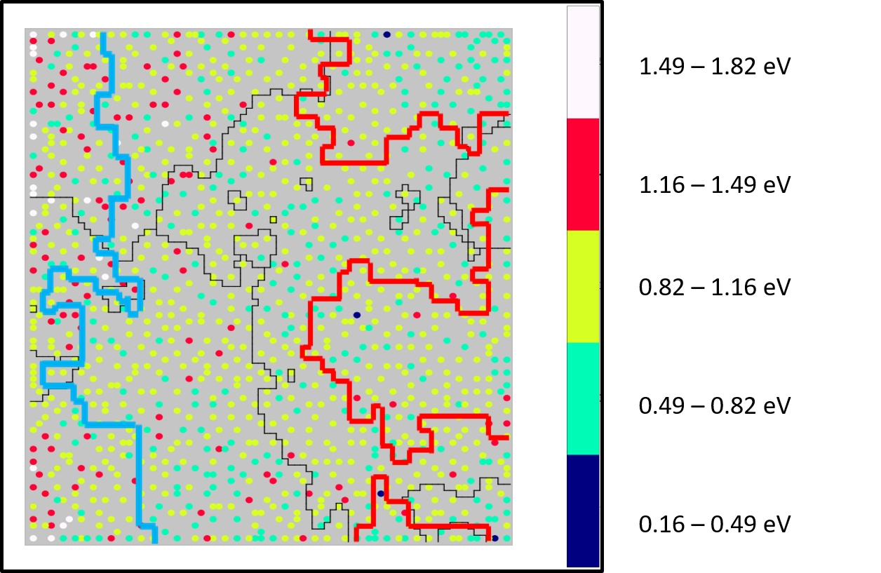
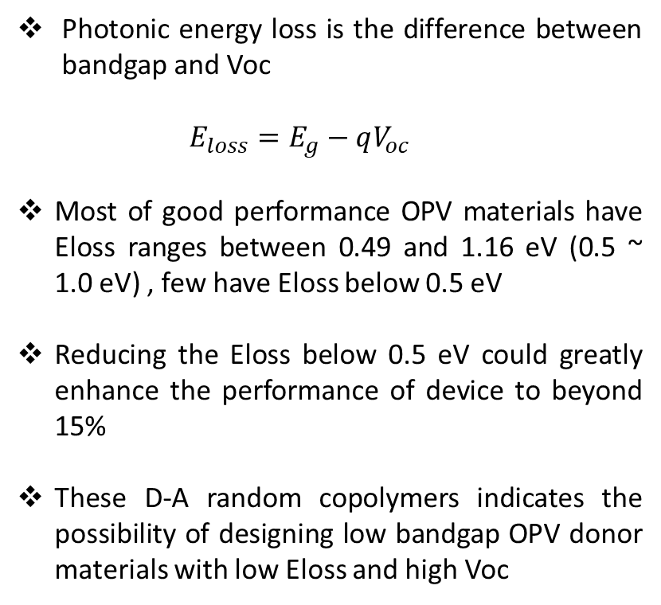
E_{g} and E_{loss}
Photonic energy loss is the difference between bandgap and Voc
$$E_{loss}=E_{g}−qV_{oc}$$
Most of good performance OPV materials have Eloss ranges between 0.49 and 1.16 eV (0.5 ~ 1.0 eV) , few have Eloss below 0.5 eV
Reducing the Eloss below 0.5 eV could greatly enhance the performance of device to beyond 15%
These D-A random copolymers indicates the possibility of designing low bandgap OPV donor materials with low Eloss and high Voc

Slide 16
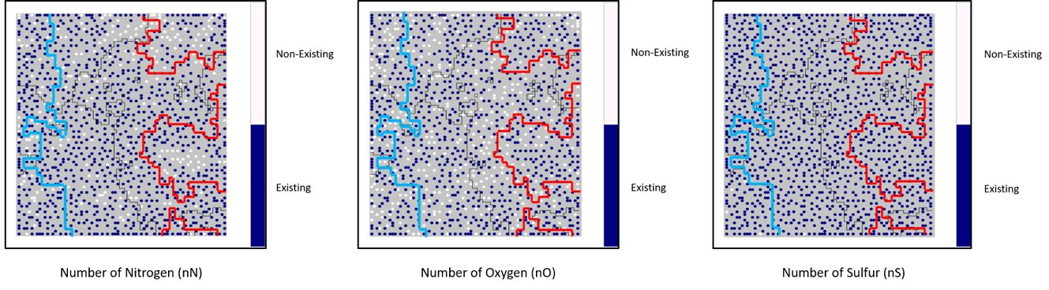
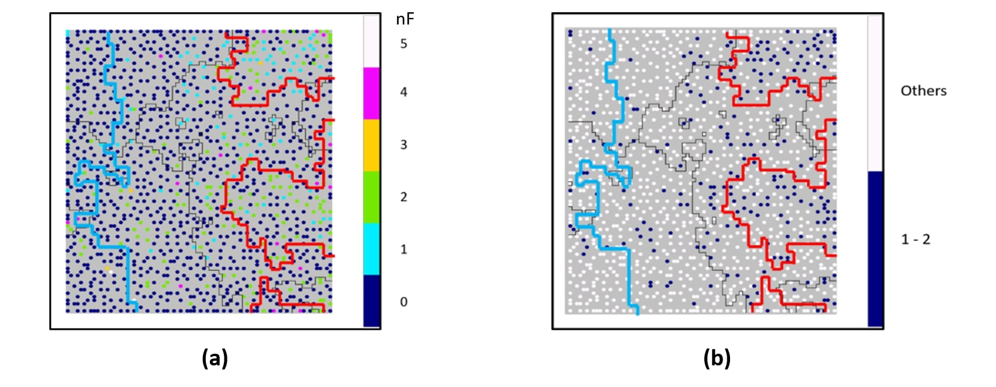
Number of Elements
Notes:
The general existence of S inside of polymers as shown in figure 7 suggests the existence of thiophene rings inside of the polymers, therefore, we project some geometrical information of the polymers on the cluster map in search for more patterns for high PCE polymers.
we also classify the polymers based on the number of the F atoms in the polymer chain, and found out that the distribution of the polymers that contain 1 to 2 F atoms aligns well with the high-PCE region, but the polymers with none or more than 2 F atoms do not show this pattern. Given this insight from the ML results, we did some further data analysis and found that 21% of materials in our data set contain F atoms, but 44% of high-PCE materials have F atoms in their backbone structure. Among the 44% of high-PCE materials that have F atom in their backbone structure, more than 90% of them have 1 or 2 F atoms, which constitute 40% of high PCE materials.

Slide 17
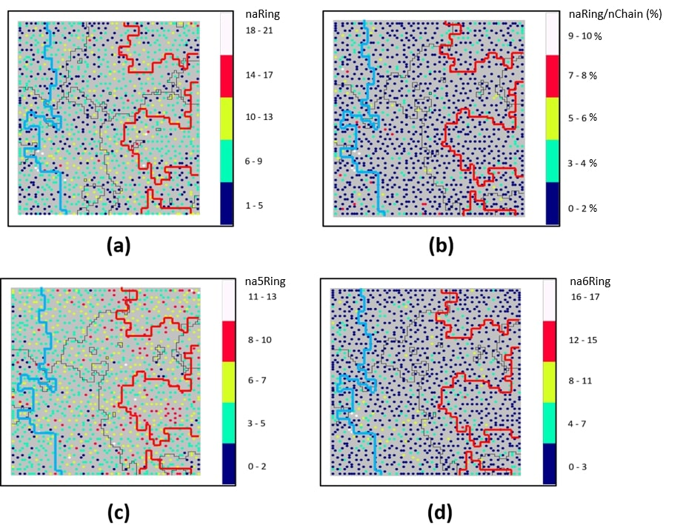
Other Molecular Descriptors
The addition of thiophene rings can improve the fill factor and morphology while designing donor-acceptor copolymers.
Prior research shows that the number of benzenes has a relationship with the performance of OPV materials.
(a) Most high-PCE materials have 6 to 9 aromatics rings within their backbone structures.
Most of the studied polymers have 3 to 7 thiophene rings in their monomer structure (d)
Information projected cluster map of (a) total number of all aromatic rings (naRing), (b) ratio between naRing and nChain (naRing/nChain), (c) number of 5-membered aromatic rings (na5Ring) and (d) number of 6-membered aromatic rings (na6Ring) on the cluster map. PCE boundaries are shown on maps in red line.
Notes:
$$γ$$
According to some research, the addition of thiophene rings can improve the fill factor and morphology while designing donor-acceptor copolymers.
Prior research shows that the number of benzenes has a relationship with the performance of OPV materials [54].
As shown in figure 9a, we found that most of high-PCE materials have 6 to 9 aromatics rings within their backbone structures.
We then project 5-membered rings (usually thiophene rings) to the cluster map and discovered that most of the studied polymers have 3 to 7 thiophene rings in their monomer structure, as shown in figure 9d. Even though we did not observe a correlation between the number of aromatic rings and high PCE values, we did expose the trend in current research in this field to focus on polymers containing 3 to 7 thiophene rings.
The increase of aromatic rings generally leads to a lower solubility and worse BHJ network, which can be facilitated by increasing the number of side alkyl chains.
The naRing/nChain projected cluster map (figure 9b), however, does not show a good correspondence with the PCE value distribution, suggesting that the scaling law is not preserved.
Namely, the high-performance polymers with many aromatic rings do not require many alkyl chains to ensure good solubility, which is a pre-requisite for strong stacking effect and high hole mobility.
Thus, nonlinear effect of alkyl chains (branched and linear) and backbone aromatics on the solubility and crystallinity of polymers should be clarified in due course.

Slide 18
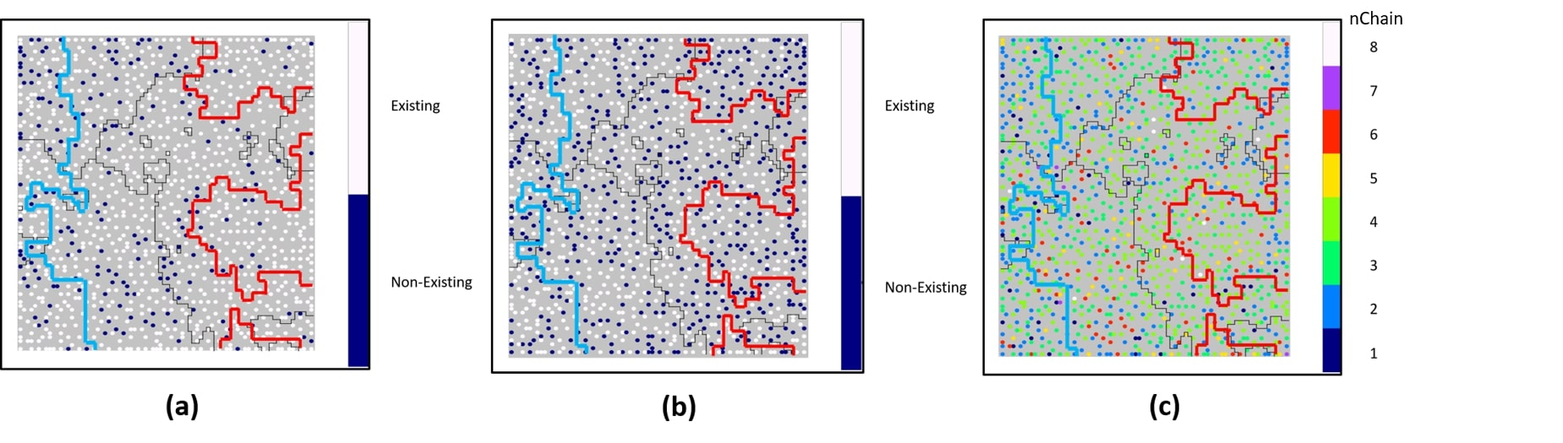
Side Chains, Branched or Linear
Information projected cluster map of (a) number of branched chains, (b) number of linear chains, (c) number of side chains in the monomer (nChain). PCE boundaries are shown on maps in red line.
Notes:
They present the projection of the number of branched and linear alkyl chains on the cluster map.
most polymers studied have branched side chains, whereas there is no obvious preference with respect to the existence of linear side chains in the materials being studied. By projecting the number of the side chains to the cluster map (c),
we found that most materials have 2 to 4 side chains attached to the backbone structure. Even though we cannot find a pattern for exact number or length of side chains on simple visualizations, at least we discovered that the majority researchers who studied fullerene OPV system reported polymers with 2 to 4 side chains containing at least one branched side chain.

Slide 19
Conclusion
The donor polymers with 1 or 2 fluorine atoms tend to have higher PCE values; more than 90% of polymers with 1 or 2 fluorine atoms have PCE values higher than 6.3%. Polymers containing none or more than 2 fluorine atoms do not exhibit the same pattern of having high PCE values.
Molecular weight of the donor polymers does not play a dominant role in influencing the PCE performance when M_{w} is compared across all polymers with different structures, different chemical components, and different geometry.
Most systems that have low photonic energy loss also have high PCE values. For high photonic energy loss polymers, only the one with wide bandgap can achieve high PCE performance.
Most donor polymers that are currently under study by materials researchers have branched side chain.

Slide 20
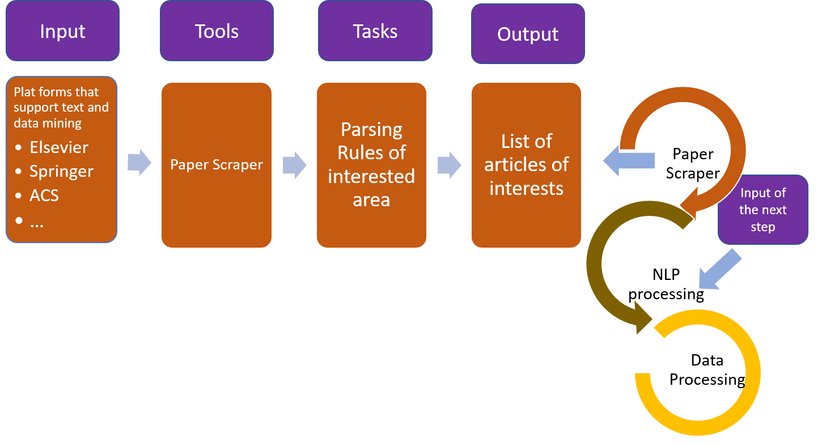
Future Work
One solution to the lack of data is to collect them, and manually doing them will cost too much time and resources
Designing a workflow that can extract specific information from literature can help us to easily build a database
The workflow include
Collection of original resources
Content / information retrieval

Slide 21
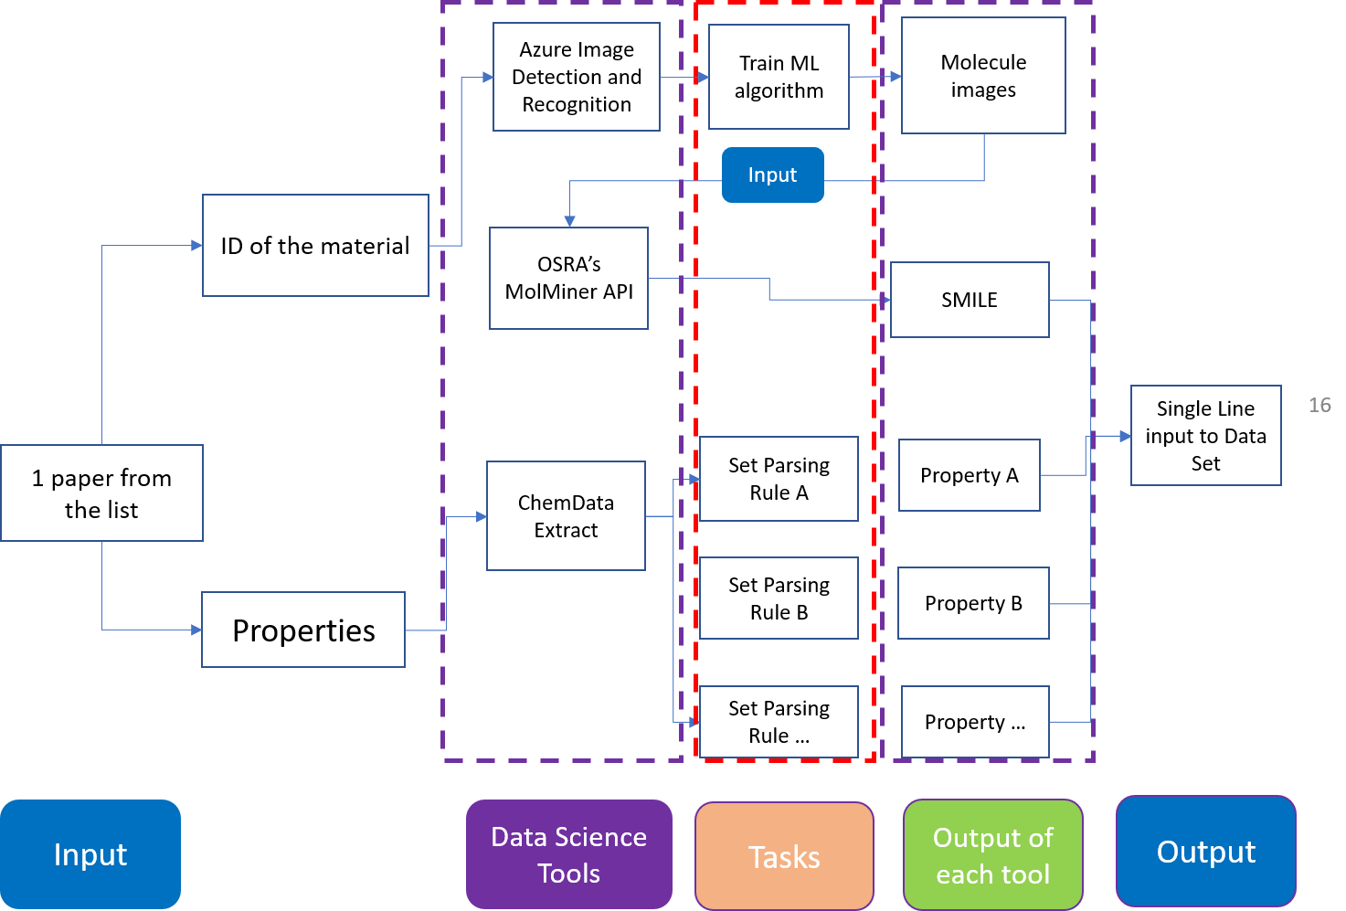
Single Line Workflow
Targeting OPV-related papers from major scientific platforms and export them in batch
Design parsing rules for content extraction
Extract information using NLP model
Property name and value (Jsc, Voc, FF, PCE, etc.)
Tables
Figures (molecule, UVVIS, JV-Curve, Spectroscopy, etc.)

Slide 22
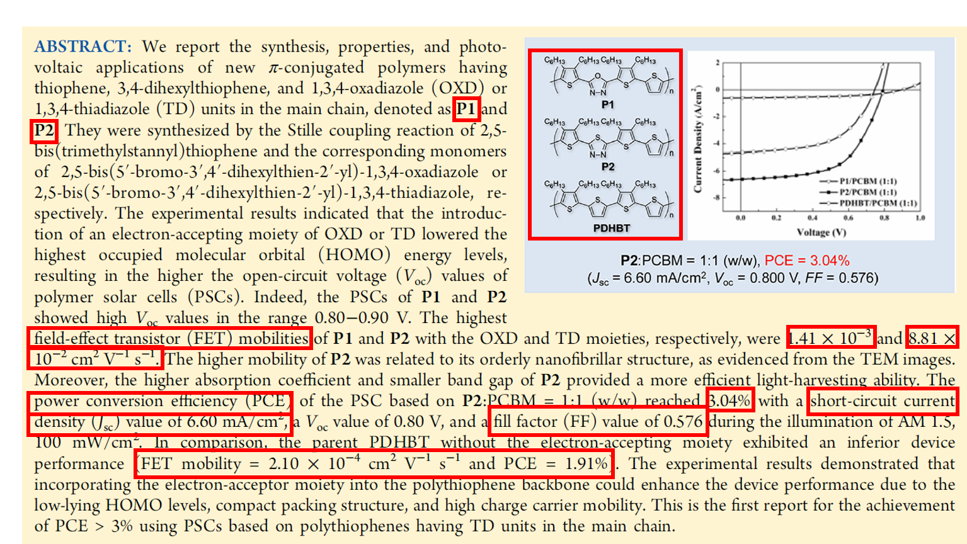
From Higashihara, T.; Wu, H.; Mizobe, T.; Lu, C.; Ueda, M.; Chen, W. Synthesis Of Thiophene-Based Π-Conjugated Polymers Containing Oxadiazole Or Thiadiazole Moieties And Their Application To Organic Photovoltaics. Macromolecules 2012, 45 (22), 9046-9055.

Slide 23
Thank you
Great thanks to:
Professor Jenekhe’s lab members
Professor Ohuchi’s lab members

